Slide 1
SMA 2230 Lecture 3

Slide 2
Coverage
Discrete
Continuous
Properties of c.d.f

Slide 3


DISTRIBUTION FUNCTION

Slide 4




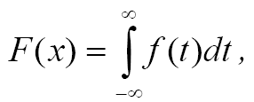
DISTRIBUTION FUNCTION

Slide 5


DISTRIBUTION FUNCTION

Slide 6

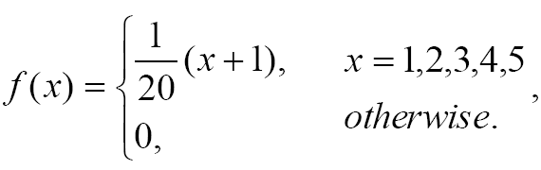
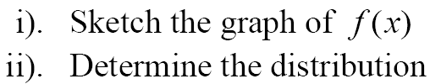
DISTRIBUTION FUNCTION

Slide 7

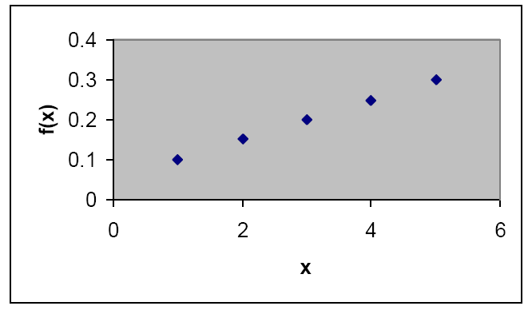
DISTRIBUTION FUNCTION

Slide 8



DISTRIBUTION FUNCTION

Slide 9
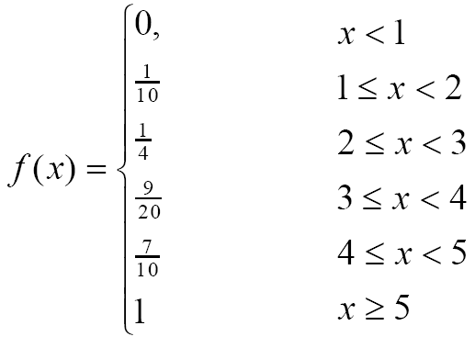
DISTRIBUTION FUNCTION

Slide 10

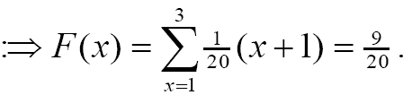

DISTRIBUTION FUNCTION

Slide 11
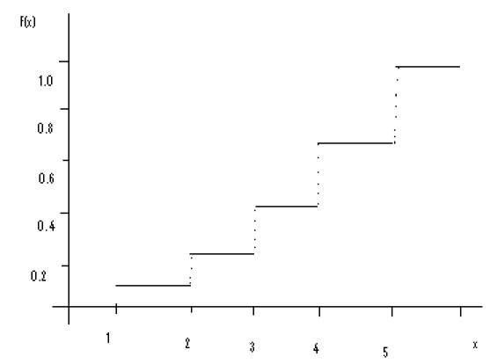
DISTRIBUTION FUNCTION

Slide 12






DISTRIBUTION FUNCTION

Slide 13



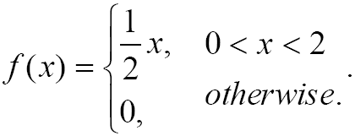
DISTRIBUTION FUNCTION

Slide 14


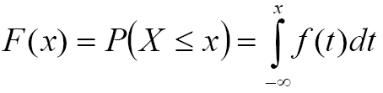
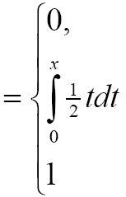

DISTRIBUTION FUNCTION

Slide 15
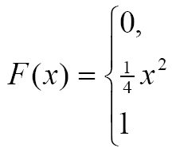
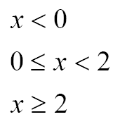
DISTRIBUTION FUNCTION

Slide 16
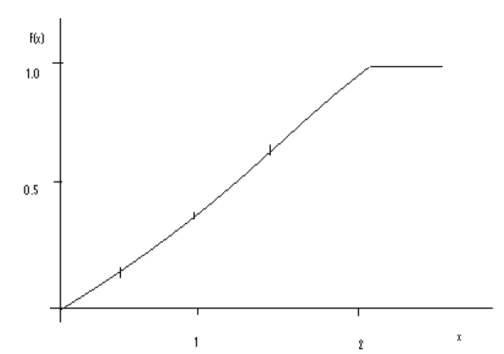
DISTRIBUTION FUNCTION

Slide 17


DISTRIBUTION FUNCTION

Slide 18


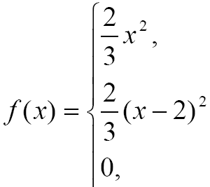
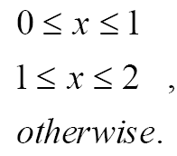
DISTRIBUTION FUNCTION

Slide 19
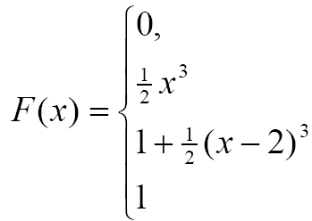
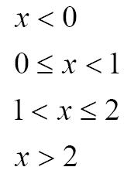

DISTRIBUTION FUNCTION

Slide 20

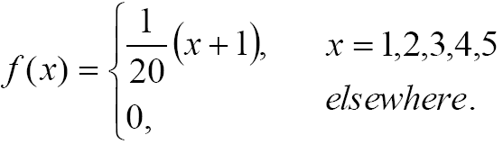


DISTRIBUTION FUNCTION

Slide 21

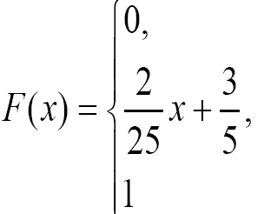
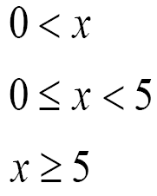

DISTRIBUTION FUNCTION

Slide 22
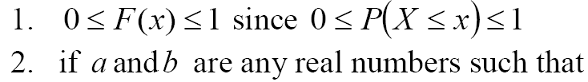




DISTRIBUTION FUNCTION

Slide 23





DISTRIBUTION FUNCTION

Slide 24

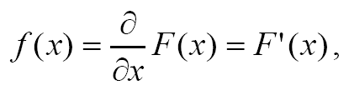
DISTRIBUTION FUNCTION

Slide 25



DISTRIBUTION FUNCTION

Slide 26
12:04:52 PM
END

